Slide 1
2017 KDD Application of Data Analysis Technology in Sports Prediction
数据挖掘课程论文阅读
第X小组
Notes:
加上组员信息

Slide 2
Paper 1
Anti xxx [18] team skill
做了什么，选取什么方法
Result

Slide 3
Paper 2
[26] 或其他 Prediction
做了什么，选取什么方法
Result

Slide 4
Sports are extremely surprising
Unpredictability cannot be avoided
Skill
Luck

Slide 5
Goals & Methods
Evaluate the luck and skill influence in sports leagues
Skill influence -> Ф coefficicent
Significant test
Which teams should be removed to make a league random
Estimate the teams' skill
Teams' skill in a season/league
What explains skill?

Slide 6
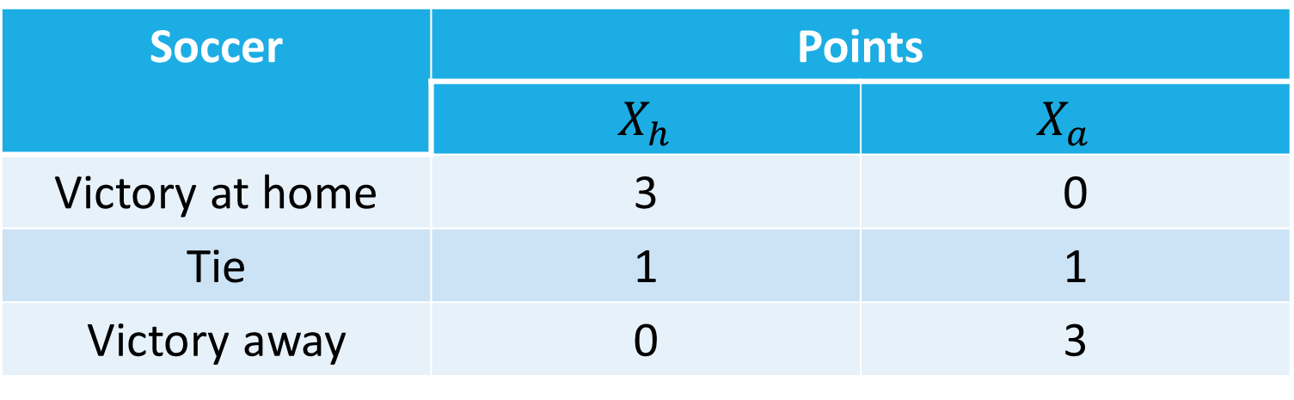
A luck and skill coefficient
For soccer:
Soccer | Points
 | $X_{h}$ | $$X_{a}$$
Victory at home | 3 | 0
Tie | 1 | 1
Victory away | 0 | 3

Slide 7
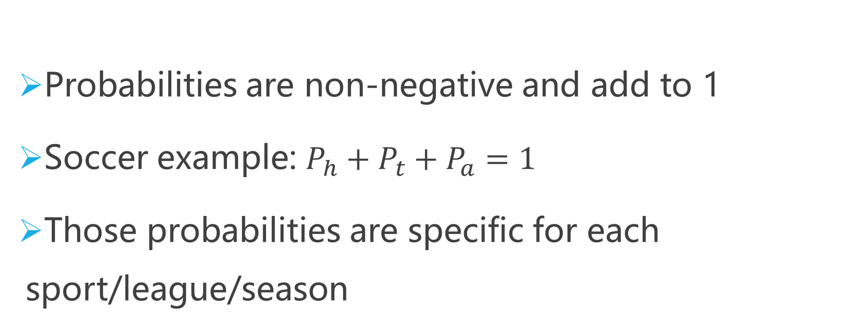
A luck and skill coefficient
Probabilities are non-negative and add to 1
Soccer example: $P_{h}+P_{t}+P_{a}=1$
Those probabilities are specific for each sport/league/season
Notes:
概率->期望->

Slide 8
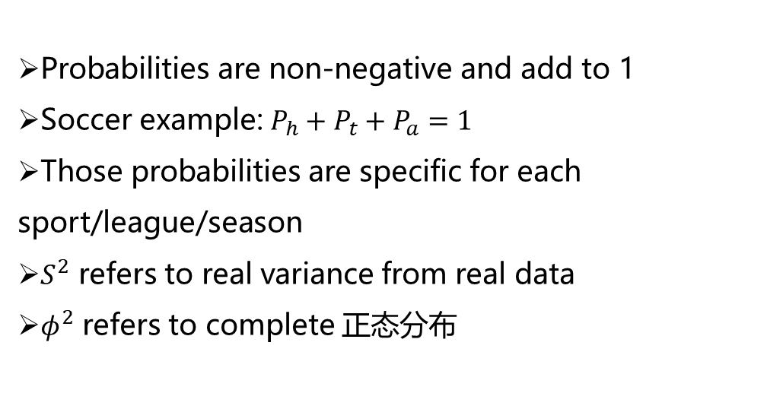
A luck and skill coefficient
Probabilities are non-negative and add to 1
Soccer example: $P_{h}+P_{t}+P_{a}=1$
Those probabilities are specific for each sport/league/season
$S^{2}$ refers to real variance from real data
$φ^{2}$ refers to complete 正态分布

Slide 9
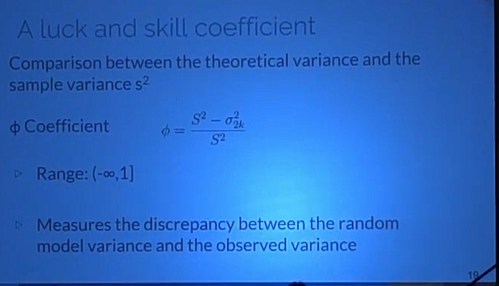
A luck and skill coefficient

Slide 10
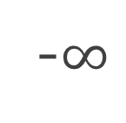
A luck and skill coefficient
-$∞$
0
1
Atypical
Luck
Skill
Close to 1: skill factor has more influence

Slide 11
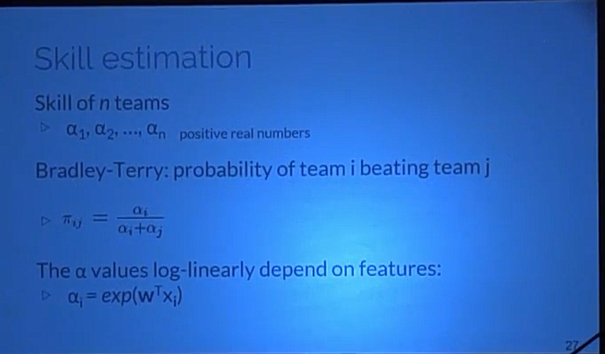
Skill estimation
Notes:
Skill estimation
Probabilities Graphical Model
Seasons/Leagues with significantly different of 0 and positive
Skill component is decomposed into explanatory features
Only basketball, NBA

Slide 12
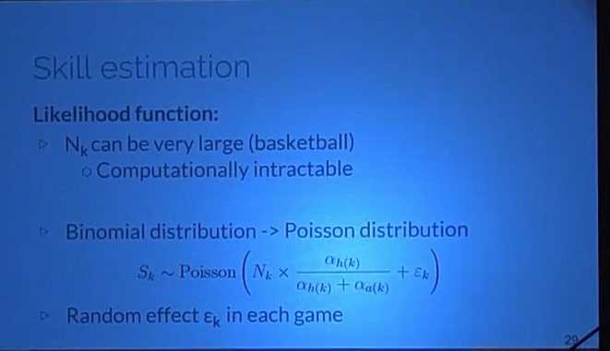
Skill estimation
Likelihood function:
Notes:
Likelihood function:
Games final score
K games and $n$ teams
$N_{k }$: total points of each team
$S_{k}$: points of the home team
$N_{k }$is a sequence of success and failures
$S_{k }$~ Binomial Distribution conditioned in $N_{k }$

Slide 13
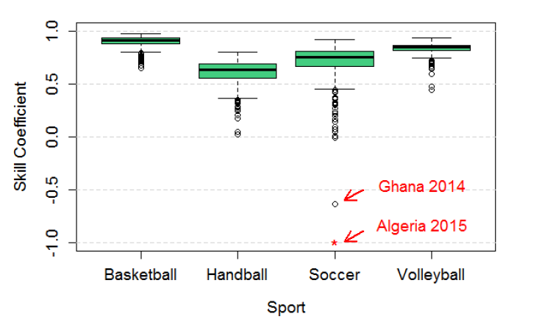
Some results with Ф Coefficient
Notes:
越接近上限1，越接近随机模型，更重要的是解释最终得分的技能组件。 篮球是最后一项成绩最大的运动。 第二个是排球，第三个是足球，第四个是手球。

Slide 14
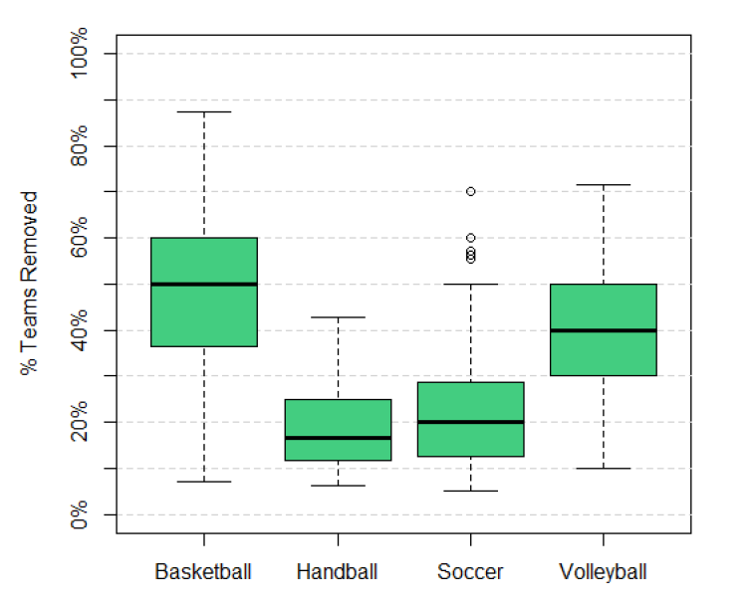
How many teams should be removed to make it random?

Slide 15
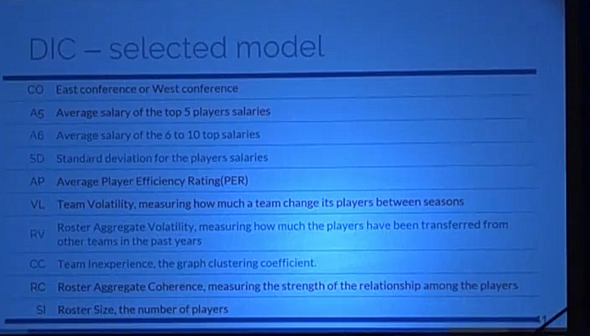
DCI-selected model

Slide 16
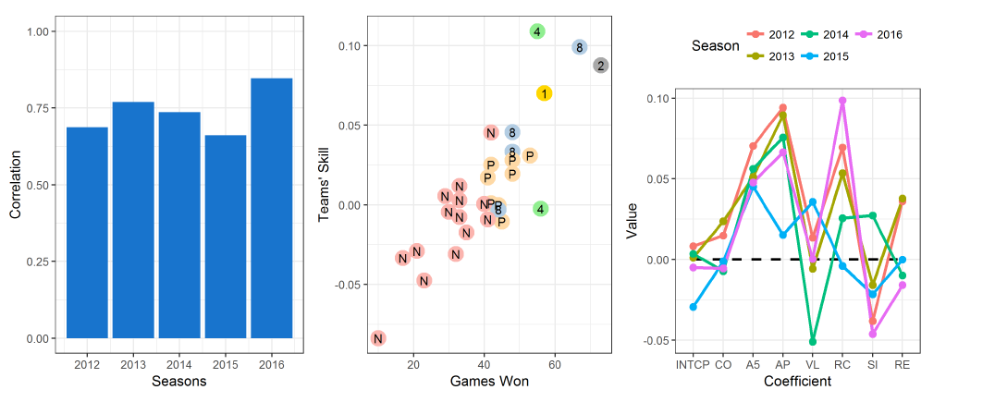

Slide 17
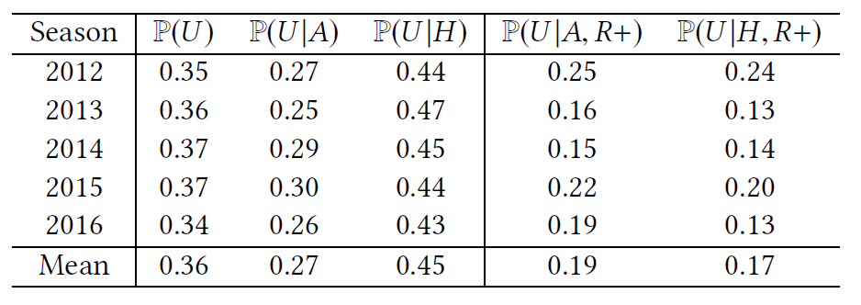
When the underdog plays at home, its winning probability increase 0.18
This effect disappears if playing against the best ones

Slide 18
Management strategy
Building smaller teams allow for higher salaries
It also increase the odds of attracting high PER players and increasing rapport(roster aggregate coherence)
Smaller, more cohesive teams have less conflicts and are easier to manage

Slide 19
Conclusion
Contribution
Ф coefficient
Which leagues and sports are more competitive
Bayesian model
Which features have more influence on the skill

Slide 20
Attractive area
Relatively isolated system seen repeatedly
Many datasets available
Popularity
Economic Relevance
Notes:
84个国家的1503个赛季的198个联赛4种不同的运动：篮球，足球，排球和手球

Slide 21
Related Work

Slide 22
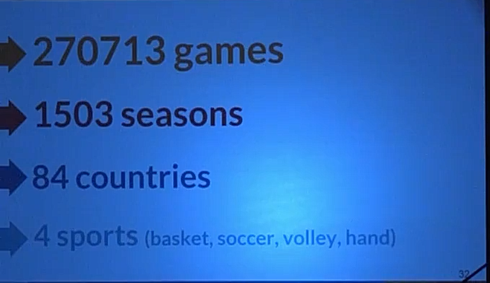

Slide 23
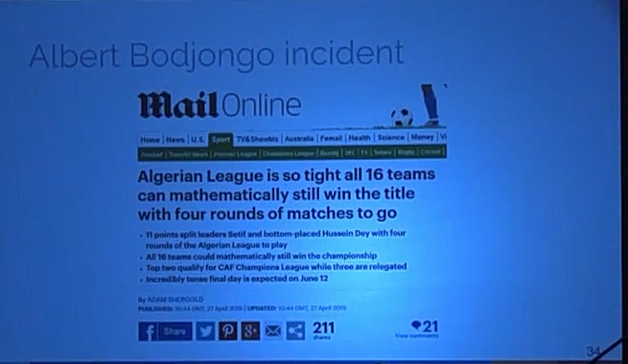
Albert Bodjongo incident

Slide 24
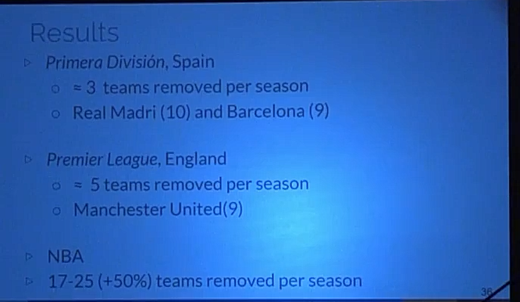
Results

Slide 25
Skill estimation
Probabilities Graphical Model
Seasons/Leagues with significantly different of 0 and positive
Skill component is decomposed into explanatory features
Only basketball, NBA

Slide 26
Dados
League
National Basketball Association(NBA)
Regular Season: round-robin system(=1230 matches)
Playoffs: 16 teams

Slide 27
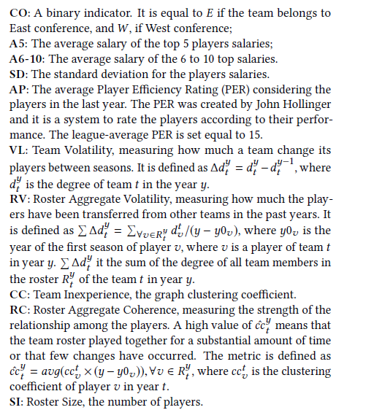
Features

Slide 28


Skill estimation
Likelihood function:
Games final score
K games and $n$ teams
$N_{k }$: total points of each team
$S_{k}$: points of the home team
$N_{k }$is a sequence of success and failures
$S_{k }$~ Binomial Distribution conditioned in $N_{k }$

Slide 29
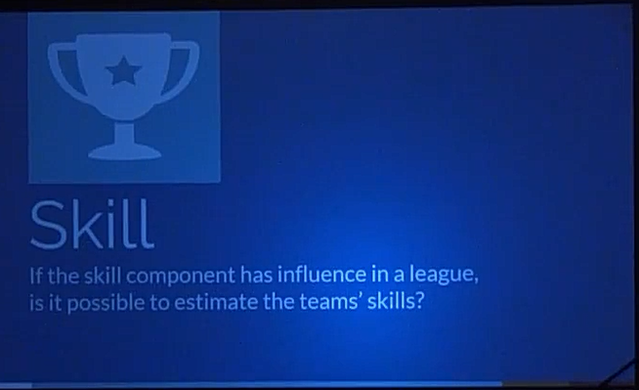

Slide 30
Results
Ф Coefficient

Slide 31
A luck and skill coefficient
-$∞$
0
1
Atypical
Luck
Skill
Close to 0: skill factor has a small influence in the results

Slide 32
A luck and skill coefficient
-$∞$
0
1
Atypical
Luck
Skill
Negative values: observed variance is LESS than the expected value under the random model

Slide 33

A luck and skill coefficient
Confidence interval(95%) around 0
-$∞$
0
1
Atypical
Luck
Skill
Monte Carlo simulation considering true the random model hypothesis

Slide 34
A luck and skill coefficient
If Ф is significantly different from 0,
how many teams should be removed from a league in order to turn it random?
By repeated simulation

Slide 35
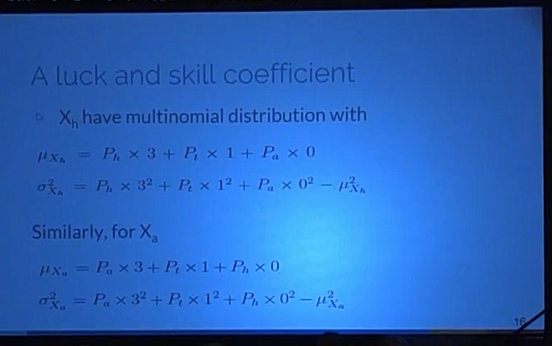
A luck and skill coefficient

Slide 36
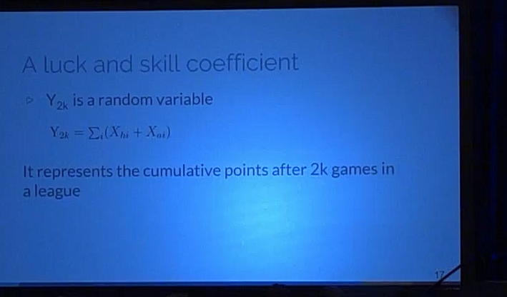
A luck and skill coefficient

Slide 37
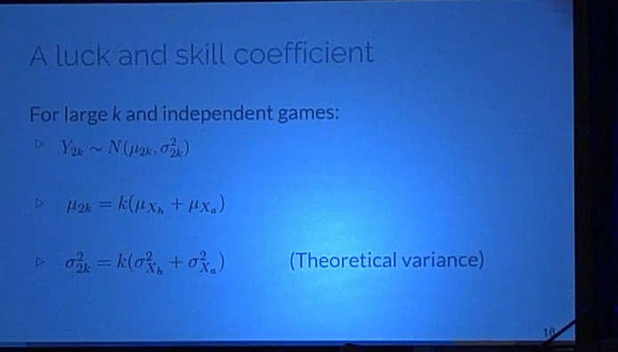
A luck and skill coefficient

Slide 38
Disentangling luck and skill

Slide 39
A luck and skill coefficient
Leagues considered
Teams with the same number of games
Each team plays twice against all others, once at home
The final result is total number of points accumulated
Contextual factors allowed(home advantage only)

Slide 40
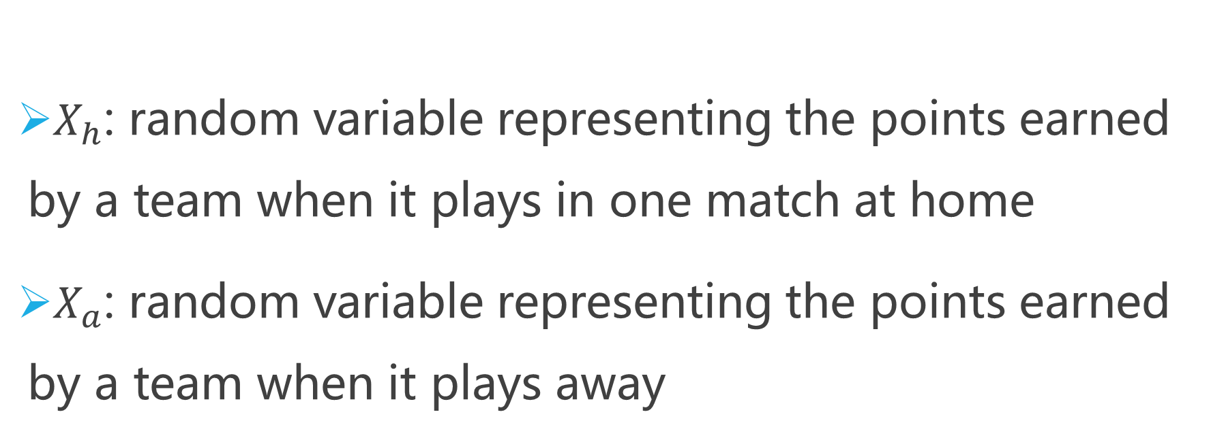
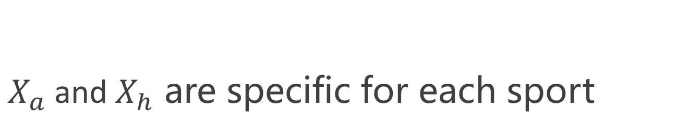
A luck and skill coefficient
$X_{h}$: random variable representing the points earned by a team when it plays in one match at home
$X_{a}$: random variable representing the points earned by a team when it plays away
$X_{a}$and$X_{h}$ are specific for each sport

